Slide 1

Lending Club Case Study

Slide 2

Business Understanding
Lending Club is a marketplace for personal loans that matches borrowers who are seeking a loan with investors looking to lend money and make a return.
When the company receives a loan application, the company has to make a decision for loan approval based on the applicant’s profile. Two types of risks are associated with the bank’s decision:
If the applicant is likely to repay the loan, then not approving the loan results in a loss of business to the company
If the applicant is not likely to repay the loan, i.e. he/she is likely to default, then approving the loan may lead to a financial loss for the company

Slide 3
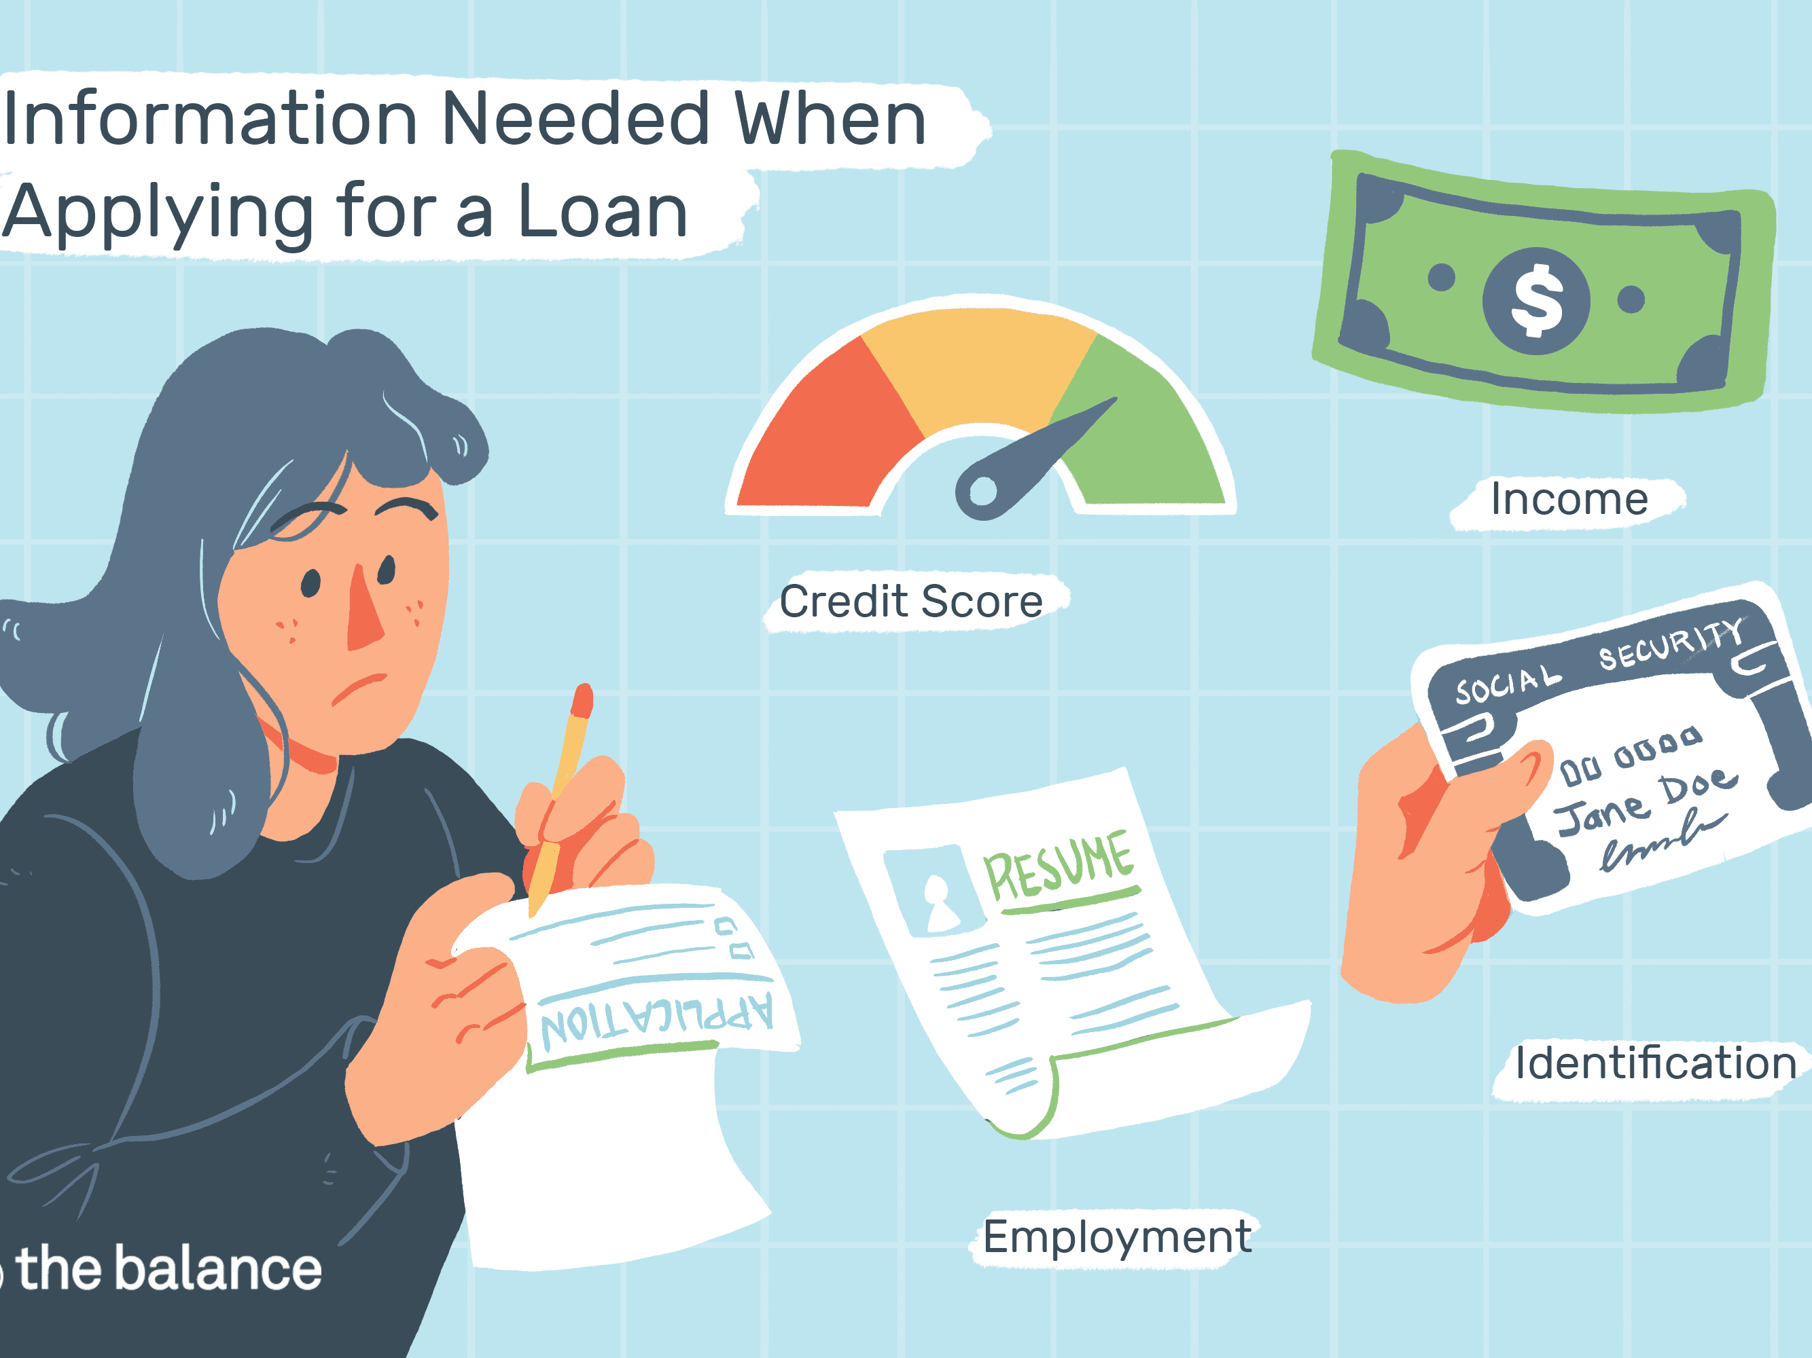
EDA Case Study - GOAL
The Aim of the case study is to identify the potential risks associated with the bank’s decision to provide the loan, based on the customers past loan applicants whether they ‘defaulted’ on loans or not and to mitigate the risk of losing money. Also, identifying the default customers involved using EDA.

Slide 4
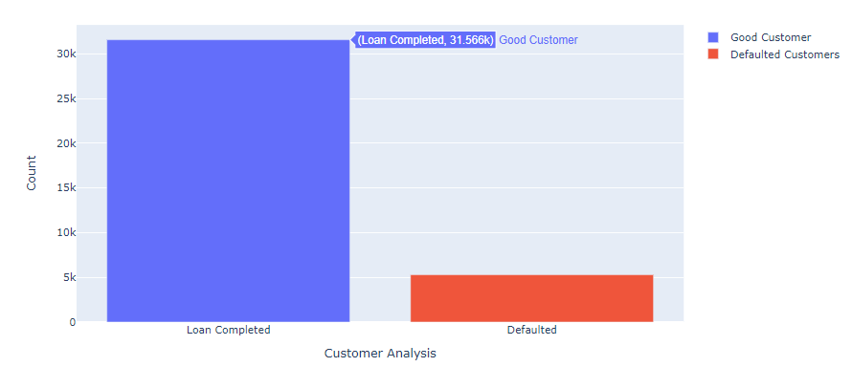
Univariate Analysis of Loan Status
Count of Loan Completed and Defaulted Applicants

Slide 5
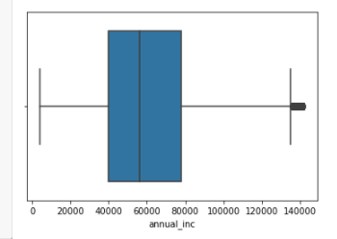
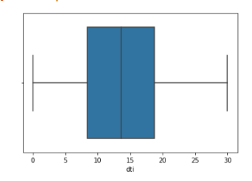
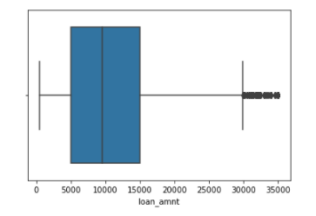
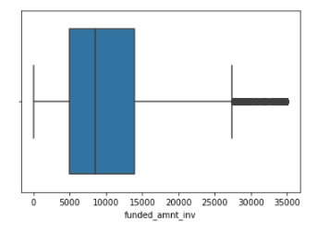
Analyzing Numerical Variables
Analyzing numerical variables – loan amount, dti, annual income and funded amount by investors

Slide 6
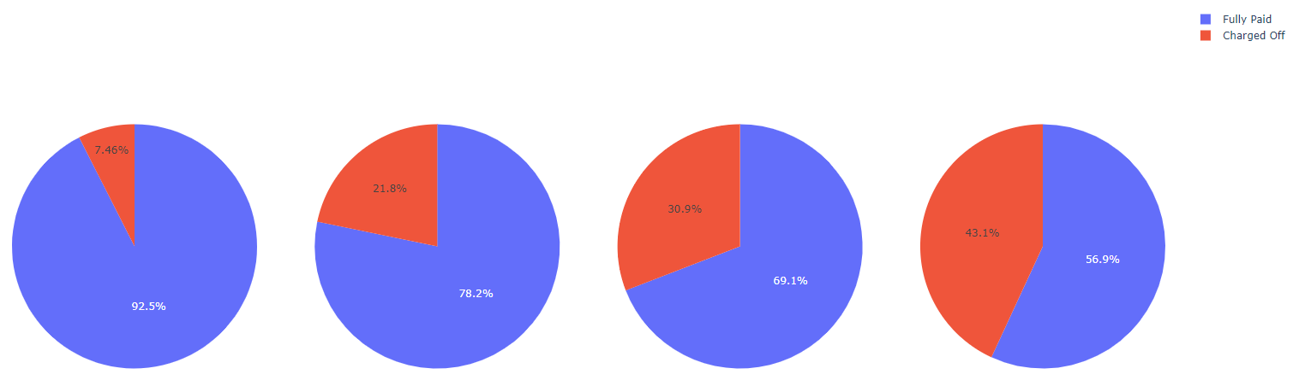
Int Rate vs Loan Status
With Increase in interest rate, the percentage of people who defaulted is on a rise. The pie chart to the extreme right depicts the same.

Slide 7
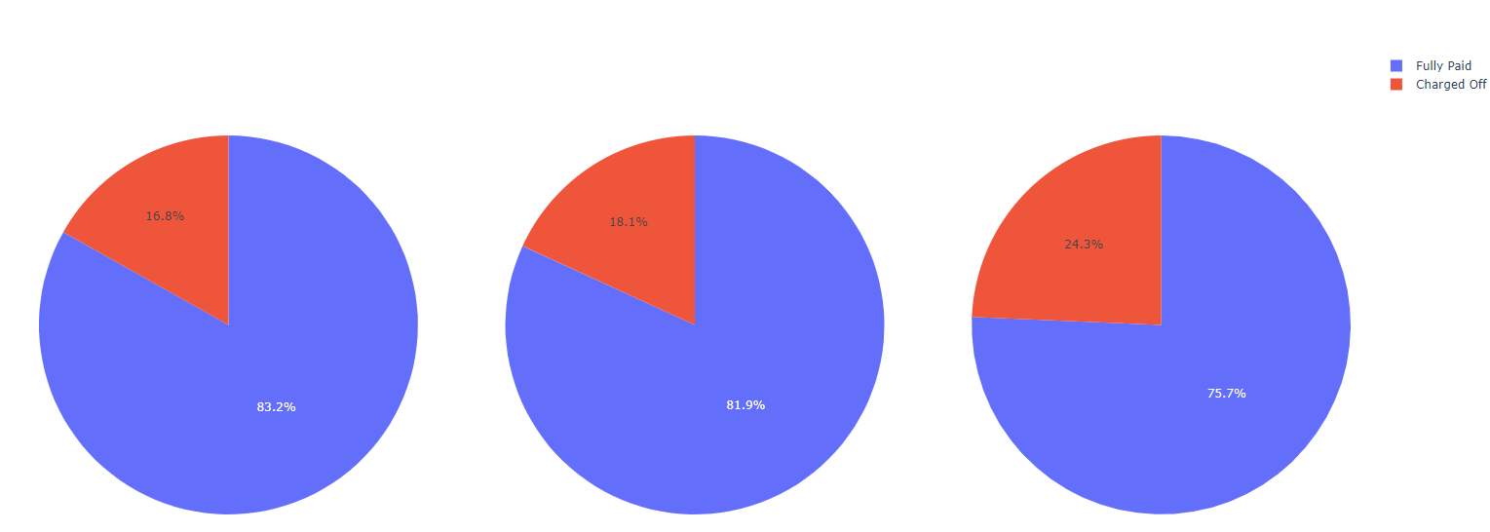
DTI vs Loan Status
With Increase in dti, the percentage of people who defaulted is also higher.

Slide 8
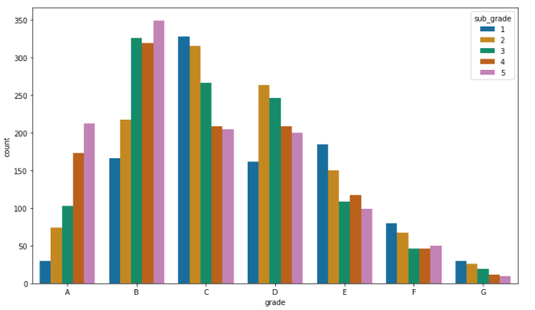
Visualizing Categorical Data
Defaulted Loan applicants against their Grades – highest being in Grade B

Slide 9
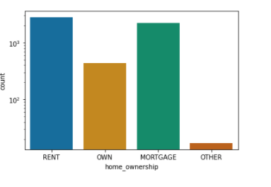
Home Ownership vs Loan Status
Defaulted Loan applicants against their Home Ownership – highest being in Grade B

Slide 10
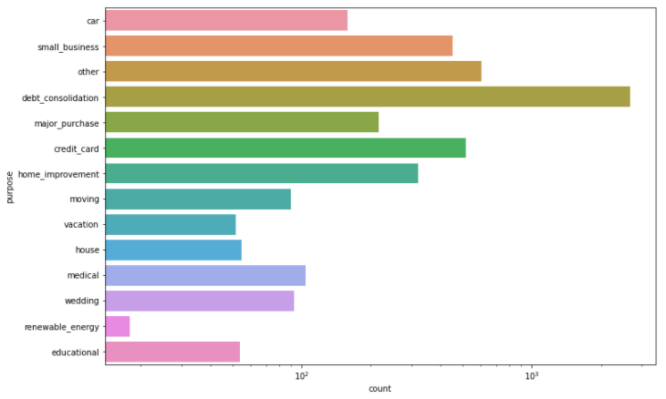
Purpose of Loan Applicationvs Loan Status
Defaulted Loan applicants against the purpose of which they are applying for a loan– highest being for debt consolidation and 2nd being unknown “other” reason.

Slide 11
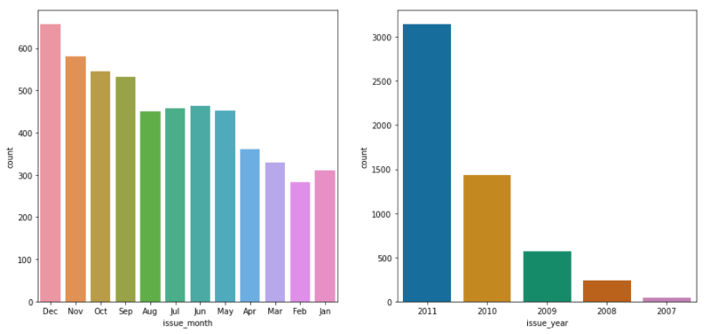
Analyzing by issued month and year
It is seen that Maximum number of defaults occured in Dec. Loan issued in the year 2011 were also as compared to other years The Year 2011 has the highest number of loan approvals

Slide 12
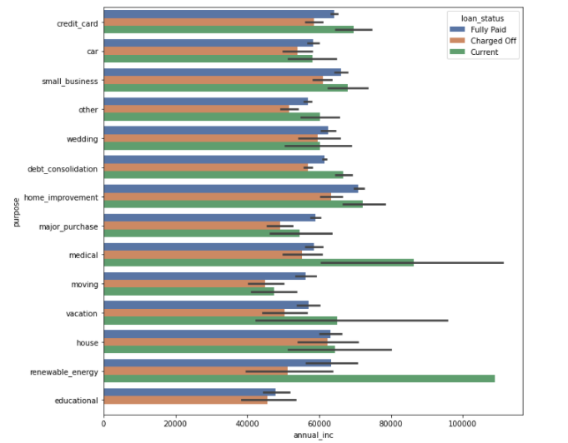
Analyzing annual income with other columns
Applicants with higher salary mostly applied loans for "home_improvment", "house", "renewable_energy" and "small_businesses“

Slide 13
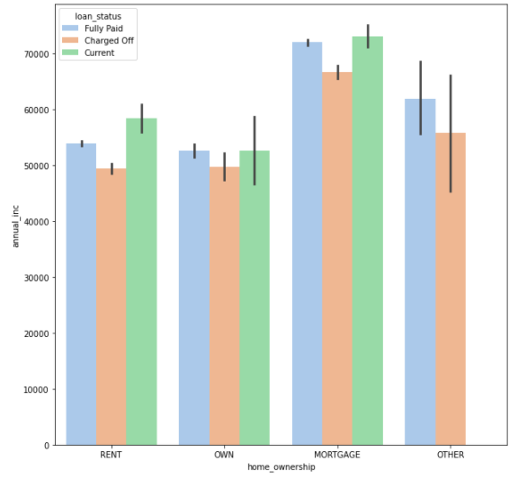
Annual Income vs Home Ownership
This graph clearly shows the count of people with respect to Annual income and their respective home ownerships.

Slide 14

Observations
The above analysis with respect to the charged off loans. There is a more probability of defaulting when :
Applicants taking loan for 'home improvement' and have income of 60k -70k
Applicants whose home ownership is 'MORTGAGE and have income of 60-70k
Applicants who have taken a loan for small business and the loan amount is greater than 14k
Applicants whose home ownership is 'MORTGAGE and have loan of 14-16k

Slide 15

Recommendations
There is a more probability of defaulting when :
Applicants having house_ownership as 'RENT' Applicants who use the loan to clear other debts When the purpose is 'debt_consolidation’
With high interest rate, more and more customers tend to default
Loan approval should be limited to people with less dti – debt to income ratio.

